Slide 1
Integrated Circuits Manufacturing Process Model
Joanna Duran, Nikhil Gupta, Max Moro

Slide 2
Agenda
Intro
Descriptive Statistics
Analysis
Interpretation
Conclusion

Slide 3


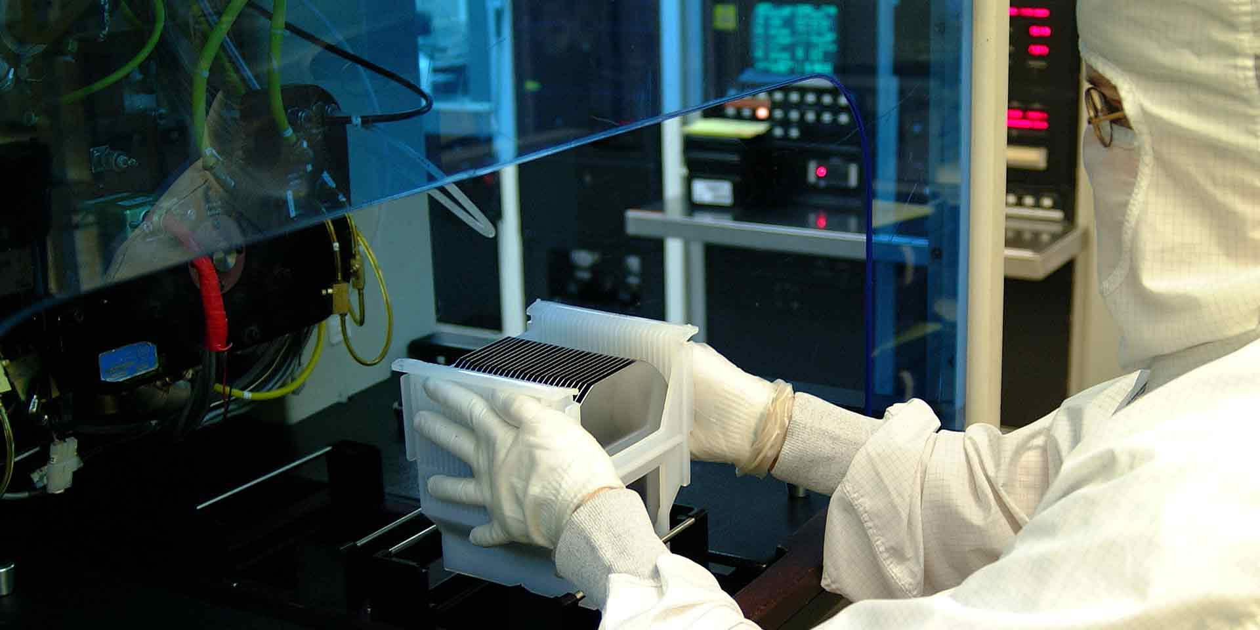
Background
Texas Instruments is a global semiconductor design and manufacturing company.
Semiconductor manufacturing process variation leads to output variables varying between a min and max value (typically measured after the manufacturing process – all R&D done – can lead to issues if the variation of output is outside target specs)
Not all values can be practically measured (due to time, resource and cost constraints)
Currently use Monte Carlos simulations but resource and time intensive
Datasets provided from which department, what time frame, how data collected, population inference?

Slide 4
Datasets
Variables controlled by engineers: x1 – x23
values range dependent on variables
between 1 to 100,
other are in nano or micro range
Process Variation (beyond human control): stat1 – stat217
Represents various statistical parameters
Variable values represent the sigma variation around the mean
Range is from -4 (sigma) to 4 (sigma)
Output Variables: y1 - y19
Represents various output variables

Slide 5
Objectives
Pick at least 1 output variable
Build a model to predict the statistical variation of the output with respect to the process
i.e. model needs to include all statistical parameters at a minimum
Build a model to predict the mean value of the output
Target accuracy: +/- 10% desired, but +/- 15% would be acceptable

Slide 6
Intro
Project Setup and Data Collection
Main objective(s)
Variables defined
Data set explanation and collection
If you created the data or randomly drew from a big monster data set you might want to consider proc power to determine an appropriate sample size to collect
Making sure the samples you collect are representative of the population you wish to draw inference or prediction
Comments on how data collection corresponds to the scope of interest (What is the population of interest that you can actually provide statistical inference on?) Maybe a subpopulation will be helpful to gain insight regardless.

Slide 7
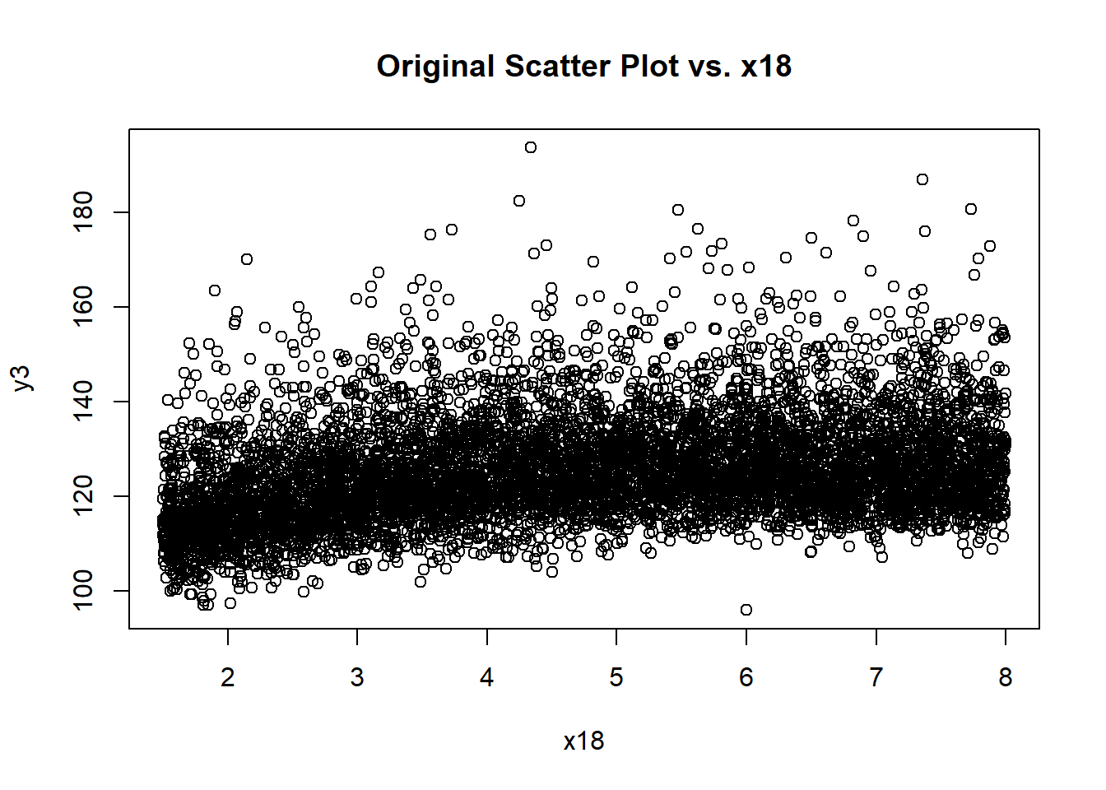
Descriptive Statistics

Slide 8
Descriptive Statistics

Slide 9
Descriptive Statistics

Slide 10
Descriptive Statistics (PLOT your DATA!!!)
Depends on your data set and objective
Do what makes sense to the story you need to tell
Univariate statistics
Histograms
Boxplots
5 number summaries, outliers in explanatory variables (might be discussed later),
Pairwise (Continuous predictors)
Scatterplot matrix
Correlation matrix
VIF values
Pairwise (Categorical predictors)
Summary stats of response by the category levels
Summary stats of other predictor by the category levels

Slide 11
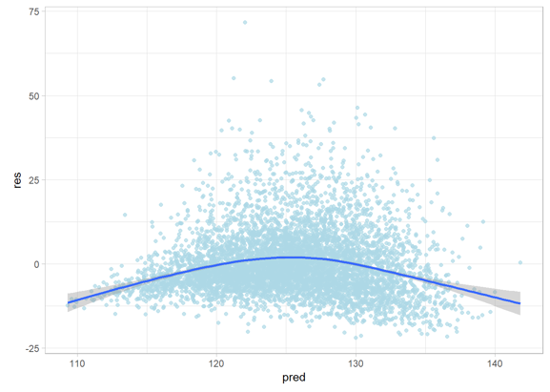
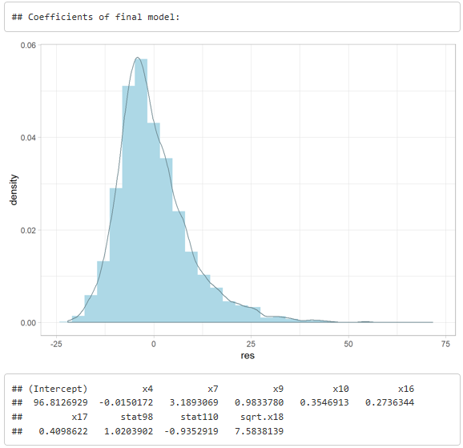
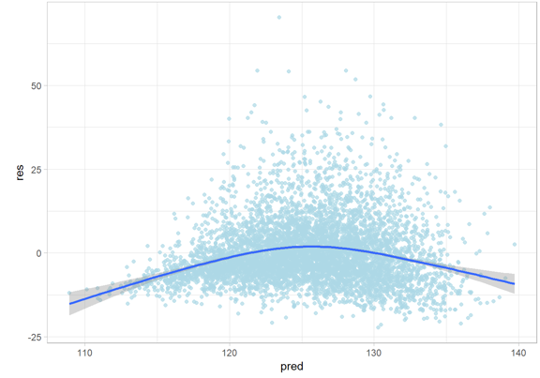
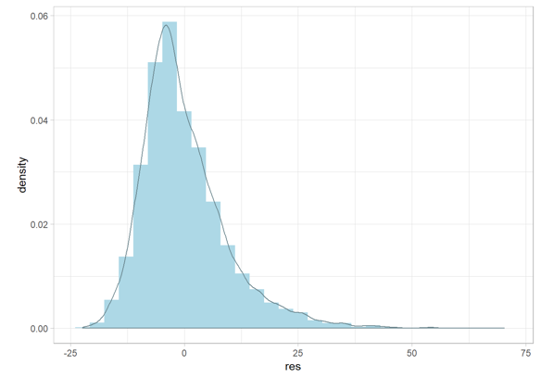
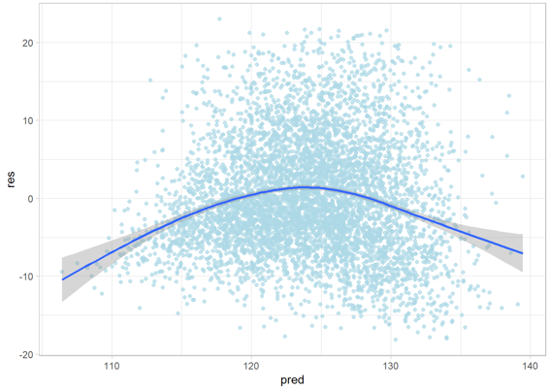
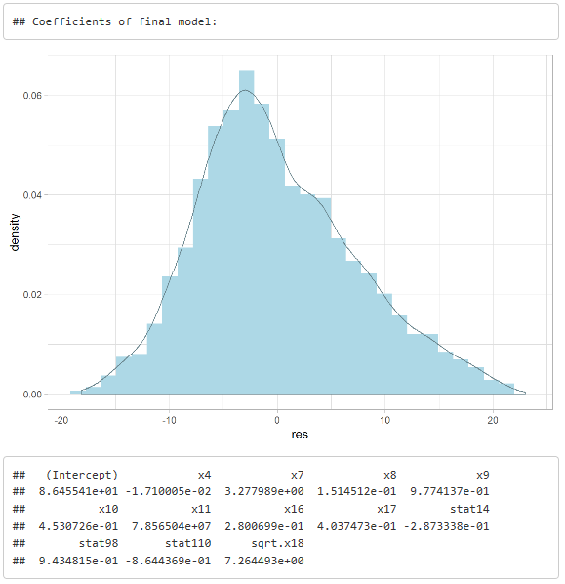
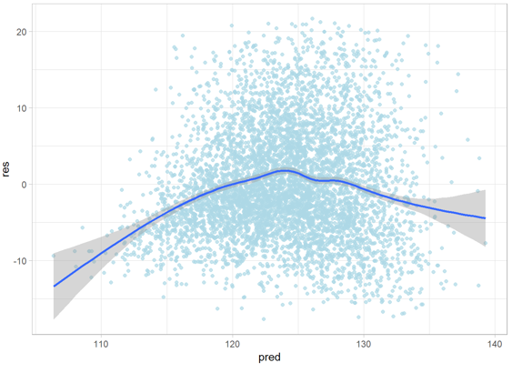
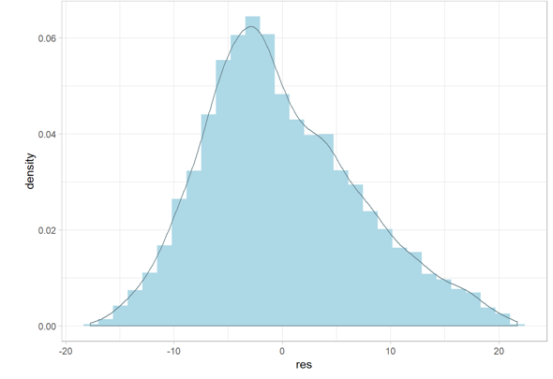
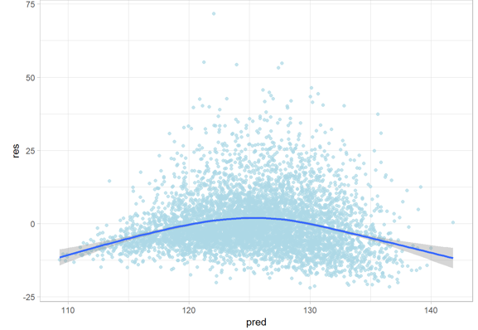
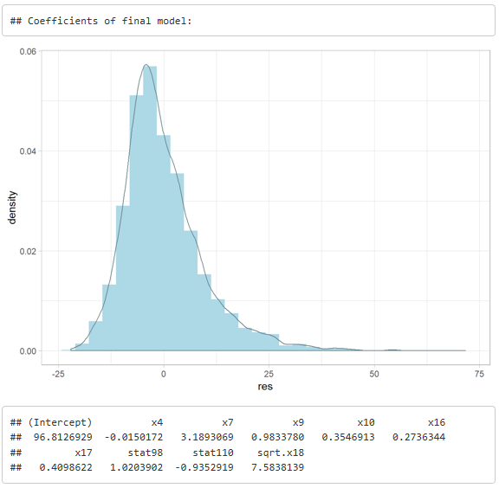
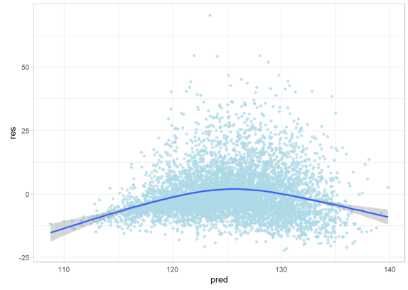
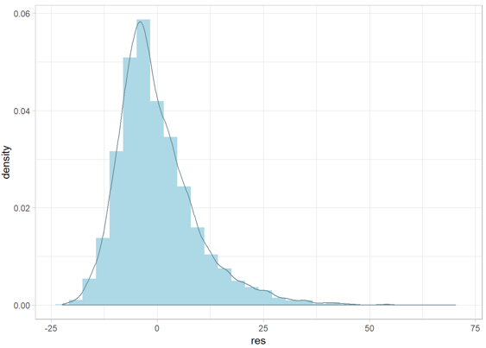
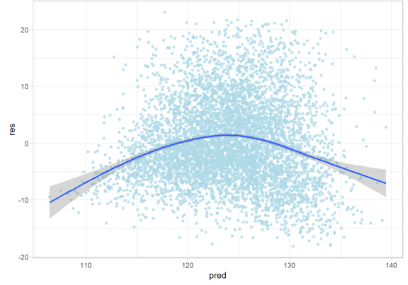


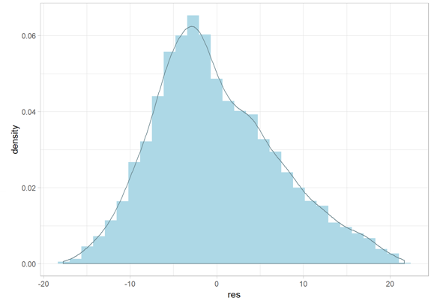
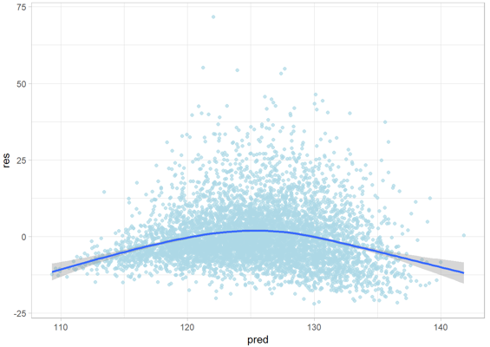
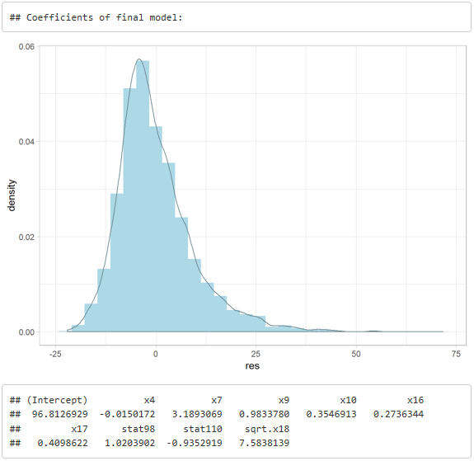
Analysis

Slide 12
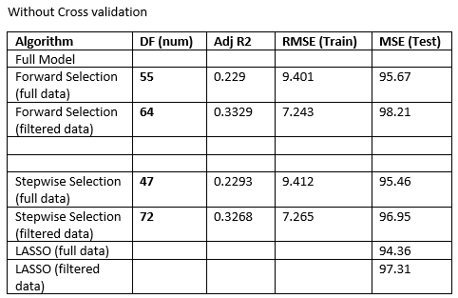
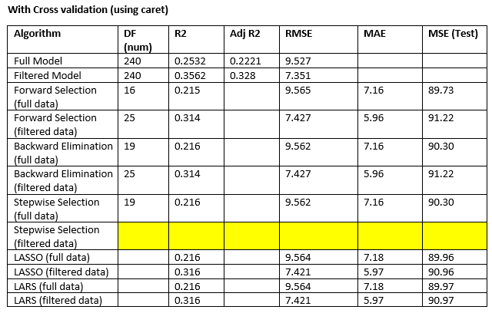
Analysis

Slide 13
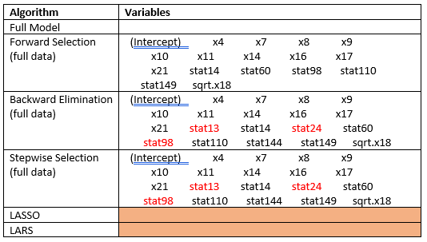
Analysis

Slide 14
Analysis
Depends on the data and objective
EDA – See paper. McGee has general guidelines for many modeling aspects throughout the unit
See Unit 2.6 and beginning of 2.7
Using Descriptive statistics- transform data, include potential variables that may make more sense, remove redundancies
Lots of predictors
Model selection approaches
Diagnostics – Leverage/Outliers / Model Assumptions /Multicollinearity
Statistical Analysis
Statement of hypothesis being conducted (Overall F test, individual t-tests)
Statistical conclusion, CI’s
ANOVA F-tables, Regression Coef. Tables, interpretation of the coefficients
If predicting, provide prediction intervals for certain values of the predictors.
Large Data sets- consider conducting training and test sets
Highly recommend this especially if you are predicting

Slide 15


Interpretation
Linking the analysis output and model jargon to what it is actually telling you in the real world and how it answers your original objective(s)
What is the population from which we can draw inference?
Does the final analysis correspond to some of the descriptive statistic information. If not, why. Is it too much variability, multi-colinearity/confounded within the predictors,
Correct interpretation of any prediction or confidence intervals. Go back to early regression chapters for reference.

Slide 16
Interpretation
Linking the analysis output and model jargon to what it is actually telling you in the real world and how it answers your original objective(s)
What is the population from which we can draw inference?
Does the final analysis correspond to some of the descriptive statistic information. If not, why. Is it too much variability, multi-colinearity/confounded within the predictors,
Correct interpretation of any prediction or confidence intervals. Go back to early regression chapters for reference.

Slide 17

Conclusion
General review of objective and findings
Could something have been done better given more time or research
If their were complexities that you know exist but lacked the expertise to deal with it, make note of it anyways and suggest that a secondary analysis could be conducted to account for those transgressions
Did any findings generate new hypothesis/ideas for future analysis
Collecting different variables
Designing of an experiment versus observational

Slide 18
Conclusion
General review of objective and findings
Could something have been done better given more time or research
If their were complexities that you know exist but lacked the expertise to deal with it, make note of it anyways and suggest that a secondary analysis could be conducted to account for those transgressions
Did any findings generate new hypothesis/ideas for future analysis
Collecting different variables
Designing of an experiment versus observational

Slide 19
Summary
Well thought out analysis
Show that you were careful in defining your objective and obtaining your data.
EDA dictates that you will try multiple models. Do not ramble on about all the things you tried unless it is absolutely imperative in the decision of the final model.
Show that you are comfortable and know how to use the techniques in multiple linear regression such as diagnostics, interpretation, testing, and model selection
Some times real data is tough and you can’t seem to fix it
Transformations
Outliers
Normality assumptions
Correlated errors
( Do not sweat this, provide the analysis to the best of your ability and if you recognize that there is some component giving you trouble make note of it in your closing remarks so that I know you at least recognized it even if you were not able to address it. This could go for the creation of the data set as well)

